Slide 1
English
Unit 1 – My World
WALT: Link sentences using an increased range of connectives.

Slide 2



WALT: Link sentences using an increased range of connectives.
I can identify connectives in a text.
I can explain why certain connectives have been used.
I can create my own sentences using more complex connectives.

Slide 3
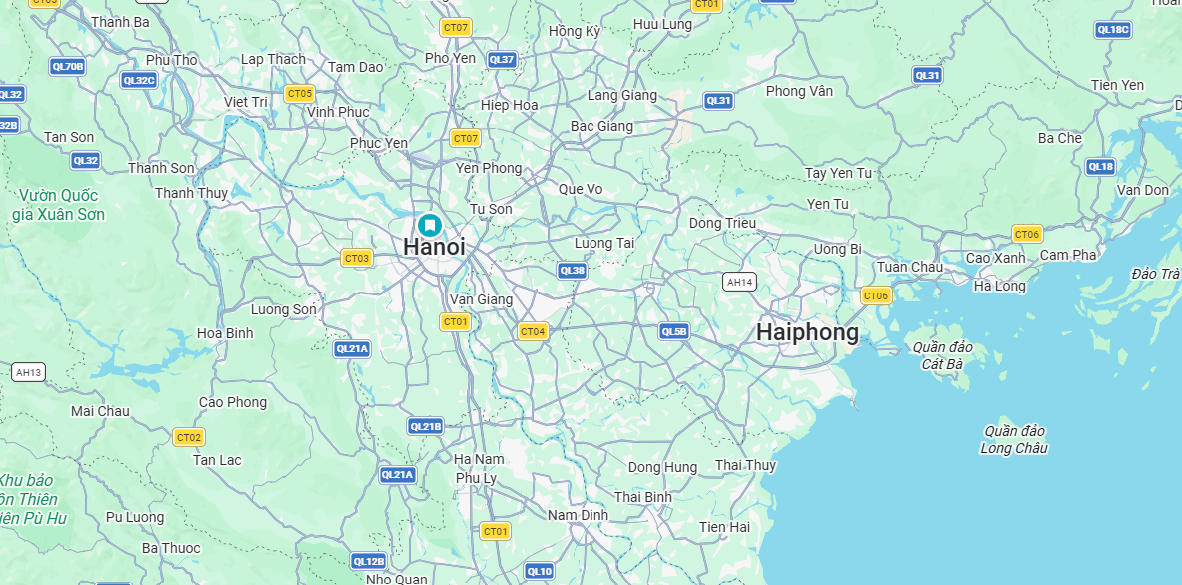
Retrieval Practice – Describe where Hanoi is to your partner using prepositions.
WALT: Link sentences using an increased range of connectives.

Slide 4
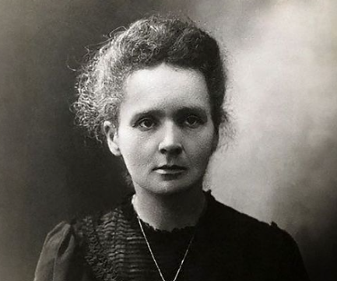

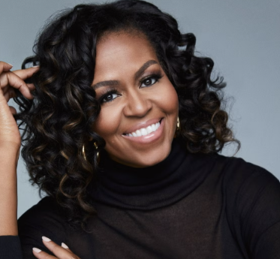


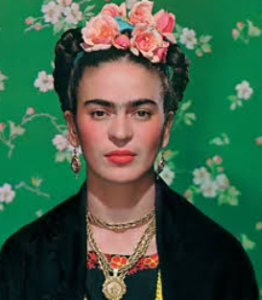
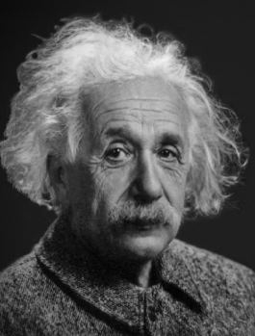
Starter – What is an inspirational person?
WALT: Link sentences using an increased range of connectives.

Slide 5
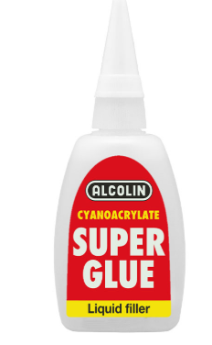
A connective is a word or phrase used to link words, phrases, clauses, or sentences together.
WALT: Link sentences using an increased range of connectives.
What is a connective?
because as if but and so
when which while before after

Slide 6
WALT: Link sentences using an increased range of connectives.
Connectives are important to use in our writing as they allow us to extend our sentences and give more detail to readers.
Over the next few lessons, we are going to use connectives to write an explanation piece on an inspirational person.

Slide 7
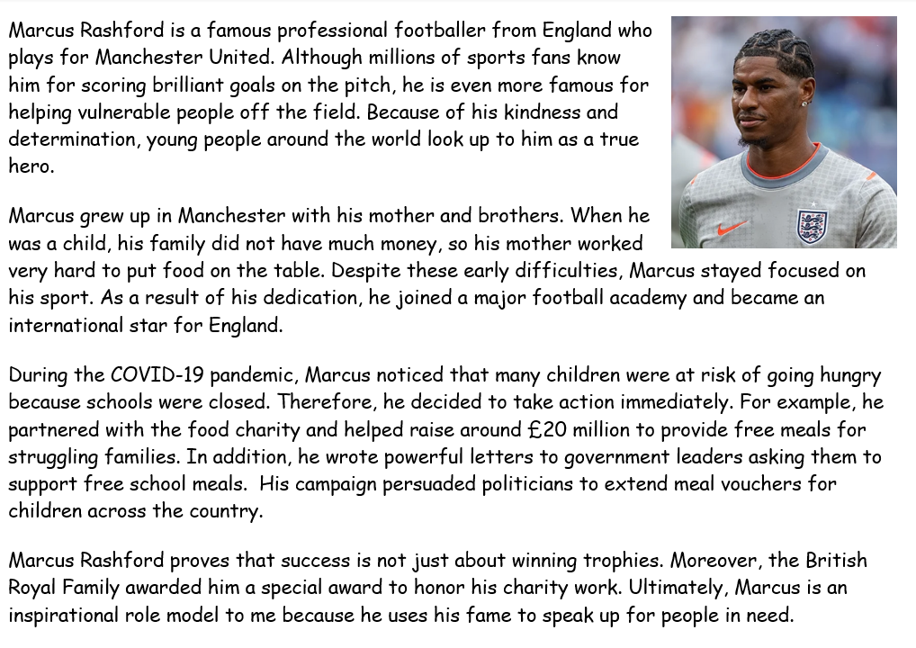
WALT: Link sentences using an increased range of connectives.
Let’s read this together.

Slide 8
WALT: Link sentences using an increased range of connectives.
Underline the connectives that you can spot.

Slide 9
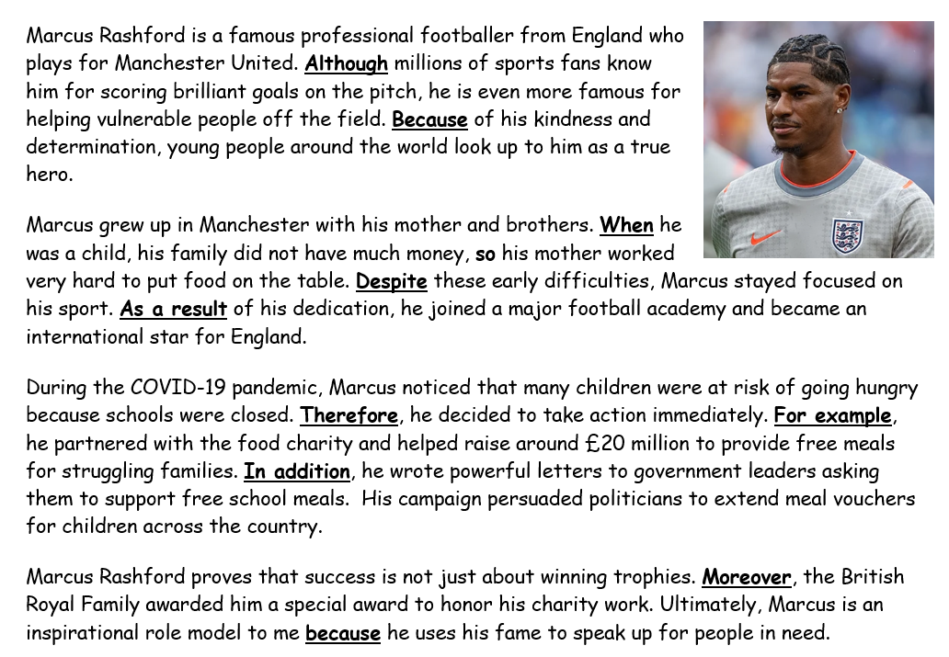
WALT: Link sentences using an increased range of connectives.
Underline the connectives that you can spot.

Slide 10
WALT: Link sentences using an increased range of connectives.
What are the jobs of each of the connectives used?

Slide 11
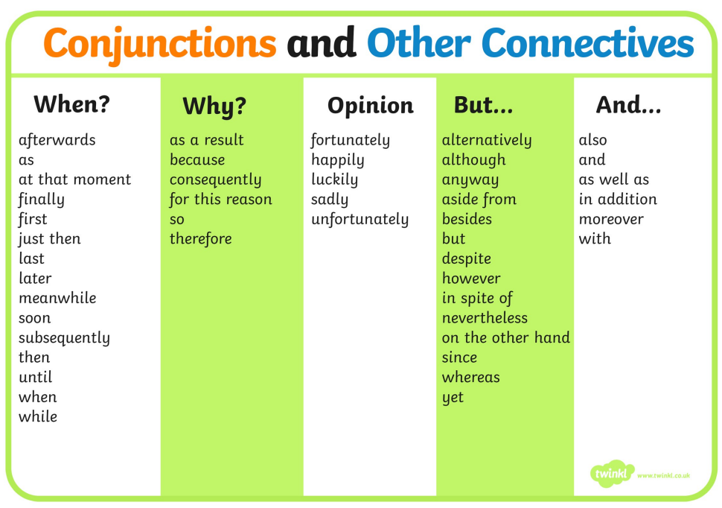
WALT: Link sentences using an increased range of connectives.
Using the connectives we’ve looked at today, write 5 sentences in your notebooks.
For example…
As a result of walking quietly throughout school, Grade 5 received 10 minutes of extra break time.

Slide 12
WALT: Link sentences using an increased range of connectives.
I can identify connectives in a text.
I can explain why certain connectives have been used.
I can create my own sentences using more complex connectives.

Slide 13
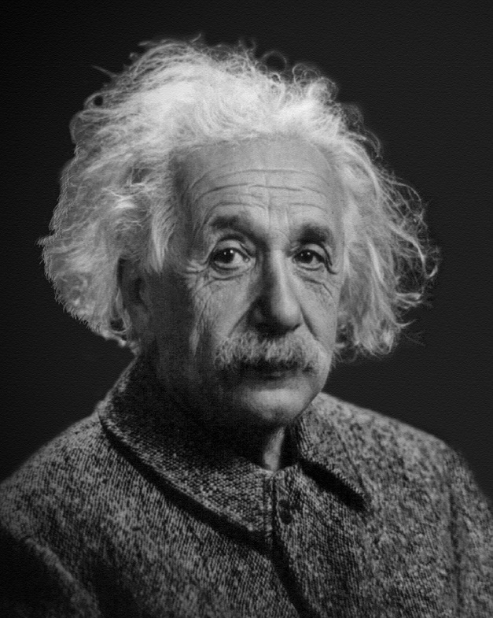
Plenary – Think of an inspirational person you could do a presentation about.
WALT: Link sentences using an increased range of connectives.
What will you need to find out about them to create a presentation?

